Slide 1
Youth Civic Engagement
Informal RFP Non-Construction 15996-24
Pre bid Conference
DATE: 9/4/24

Slide 2
SPEAKER INTRODUCTIONS
Dasha Herrin
Buyer, Procurement Division
dherrin1@coj.net
904-255-8844
Ombudsman Designate
Kenneth Darity
Chief Administrative Officer, KHA

Slide 3
DELIVERY AND CLOSING DATE
Response Delivery Location:
1 Cloud System – Supplier Portal
Search - Solicitation
Solicitation # 15996-24
Bid Closing Date 9/17/24 @ 4:00 PM

Slide 4
SUPPLIER PORTAL - Requirements

Slide 5
1. AFFIRMATION
Click on Preview Requirement Questionnaire
(1) Name and Title
(2) Company Name
(3) Bidder Acknowledgement
(4) Solicitation Silence – violations may result in rejection/disqualification
(5) Legal authorization - authorized to do business in Duval County
(6) Certification of No Conflict of interest
(7) Equal Business Opportunity – JSEB
(8) Electronic Signature
*Must complete each section

Slide 6
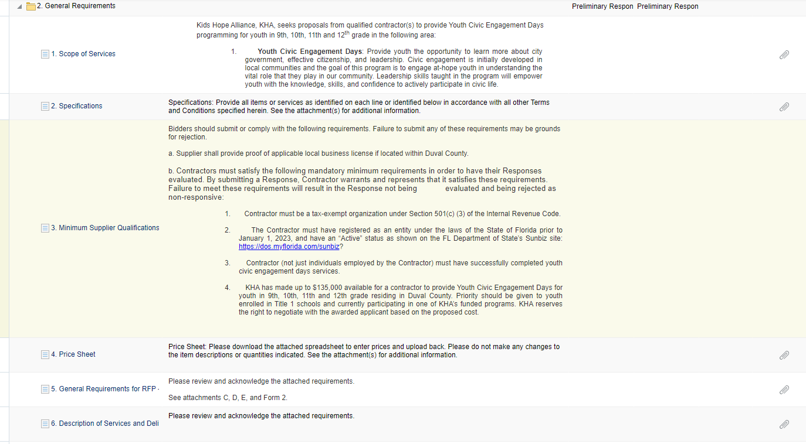
2. GENERAL REQUIREMENTS

Slide 7
2. GENERAL REQUIREMENTS
(1) Scope of Services – Learn about government, effective citizenship, and leadership
(2) Specifications - attachment (outlines the scope and requirements of the RFP)
(3) Minimum Supplier Qualification - 501©3; registered in Sunbiz no later than 1/1/23 w/ active status; successfully completed youth civic engagement days services.
(4) Price Sheet - budget form
(5) General Requirements for RFP- attachments C,D,E, Form 2
(6) Description of Services and Deliverables - deliverables attachments
(7) Response format for RFP – No more than 5 pages. Follow the directions closely

Slide 8
3. EVALUATION CRITERIA

Slide 9
3. EVALUATION CRITERIA
(1) Contractor Detail – (max 12 pts)
(2) History with civic engagement and leadership skill development – (max 12 pts)
(3) Staffing Chart – (max 8 pts)
(4) Detail of services offered – (max 12 pts)
(5) Participant recruitment – (max 12 pts)
(6) Participant engagement and event structures – (max 12 pts)
(7) Transportation Needs – (max 12 pts)
(8) Budget: See Price Sheet– (max 12 pts)
Pay close attention to scoring matrix – evaluation criteria details
Contractors must score a minimum of 80% of points overall to be considered for funding.
92 is Highest Possible Score

Slide 10
OTHER IMPORTANT REMINDERS
Maximum award: $135,000.00
Term of Agreement: October 1, 2024 – May 31, 2025 – up to three (3) one-year renewals
Target Population: 9th thru 12th graders residing in Duval County
Deadline to submit questions: September 13, 2024, 4:00PM
An addendum will be sent to all respondents
Pre-bid recording available by 9/5/24 https://www.kidshopealliance.org/RFP/RFP8.aspx
Complete survey: browser and email

